Slide 1
Multilateration Indexing
Data structures and algorithms to improve query performance for geodesic and other complex distance functions
Chip Lynch, University of Louisville, Summer, 2021

Slide 2
Agenda
Hi, I’m Chip!
Problem Statement
Multilateration Index
Query Algorithms
Experiments
Results
Conclusions and Future Work

Slide 3
Hi, I’m Chip!
About Chip
Came back to grad school for “fun”
  It’s been fun!
  Did some research, took some classes. Good times.
Data and Software Engineer for:
  KPMG / Deloitte
  NASA
  US Air Force
  SpaceX
  Passport Health (Medicare/Medicaid)

Slide 4
Real World Problems
Problem
Statement
Satellite Communications
  Fast Moving
  Extreme accuracy requirement over long distances for laser guidance
  Regularly need to find the closes Satellite/Ground Station/User Terminal (Nearest Neighbor)
Healthcare Network Adequacy
  Ensure that x% of <type of person> is within m miles of <type of health service>
    80% of female members over the age of 13 must live within 25 miles of an OB/GYN
    80% of members under the age of 16 must live within 25 miles of a pediatrician
    90% of members must live within 50 miles of an emergency room
    ...

Slide 5
Expensive Distance Functions
Problem
Statement

Slide 6
Network Adequacy
Problem
Statement
Given a non-empty set of points P and a non-empty set of query points Q in a metric space M (where P ∩ Q comprises the ‘network’), the network is ‘completely adequate’ for a distance d and a distance function D(a, b) describing the distance between points a and b for a ∈ M and b ∈ M if for every point q (where q ∈ Q) ∃ at least one point p (p ∈ P ) 3 D(p, q) <= d. Otherwise the network is ‘inadequate.’
We call a single point q ‘adequate’ itself, if it satisfies the same condition – i.e. ∃ at least one point p (p ∈ P ) D(p, q) <= d.
If, within P , we consider the largest subset P’ ∈ P where P’ is ‘completely adequate,’ then P has a “Network Adequacy Percent (NAP)” of |P’|/|P|. Note that P’ can be defined (identically) as the union of all ‘adequate’ points p ∈ P

Slide 7
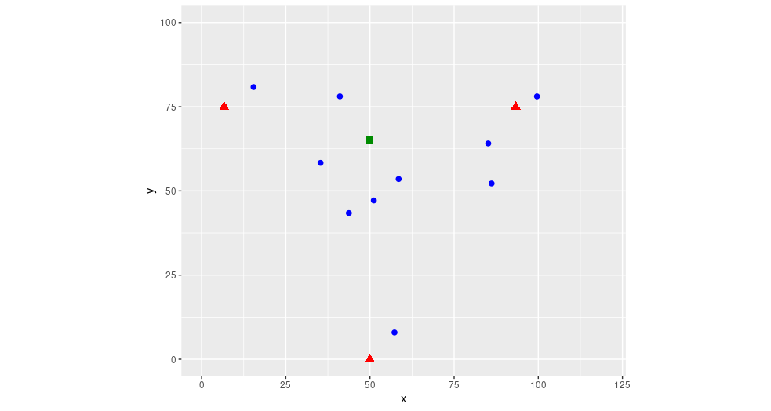
Nearest Neighbor
Problem
Statement
Given a set of search points P (blue dots), and a query point Q (green square), determine which of the points in P are closest to the query point Q

Slide 8
(Advanced) Nearest Neighbor
Problem
Statement
Constraints beyond typical NN problems:
  Constant motion – pre-processing must happen repeatedly and quickly
  Expensive distance function D(a, b)
  Queries specify subsets of points in P and Q
Includes “kNN”:
  Find the nearest k neighbors out of the set P

Slide 9
Comparing Solutions
Problem
Statement
Training Time Complexity
  the O() (typically in terms of |P|) required to pre-process the points p if any
Memory Space
  the memory requirements of the structures resulting from pre-processing
Prediction Time Complexity
  the O() required to find the closest point p ∈ P for a single query point q
Insertion/Move Complexity
  the O() complexity required to add or move (or remove) a point p ∈ P (or q ∈ Q)

Slide 10
Comparing Solutions
Problem
Statement
Training Time Complexity
  the O() (typically in terms of |P|) required to pre-process the points p if any
Memory Space
  the memory requirements of the structures resulting from pre-processing
Prediction Time Complexity
  the O() required to find the kN N ∈ P for a single point q
Insertion/Move Complexity
  the O() complexity required to add or move (or remove) a point p ∈ P
Most solutions optimize for #3

Slide 11
Existing NN Solutions
Problem
Statement
Brute Force
  Compare every point to each other and sort the resulting distances
Space Partitioning Trees
  Recursively divide points into smaller and smaller areas to reduce search space
  Examples: k-d trees and ball trees
Locality Sensitive Hashing
  Project points to lower dimensions while attempting to maintain distance relationships
Graph Based Search
  Create a network of locally nearest-neighbors
  Example: Facebook’s FAISS

Slide 12
Proposing a Solution
Multilateration
Index
The Multilateration Index
  Store distances from fixed points, rather than coordinates
  i.e. Store distances from three points around the globe for geospatial applications
Benefits:
  Allows direct comparison of distances using simple subtraction
  Can be quickly calculated and updated (particularly vs. graph and space partitioning)
  Allows error checking (many combinations of distances are impossible, unlike coordinates)
  Is easily augmented with additional data that does not affect optimization

Slide 13
Example Index:
Multilateration
Index
Index | x | y | d1 | d2 | d3
8 | 15.42852 | 80.83634 | 10.50105 | 78.09115 | 87.91872
4 | 35.32139 | 58.321179 | 33.12763 | 60.331164 | 60.14001
6 | 41.08036 | 78.065907 | 34.51806 | 52.310835 | 78.57382
2 | 43.7394 | 43.418684 | 48.67639 | 58.768687 | 43.86772
7 | 51.14533 | 47.157734 | 52.44704 | 50.520446 | 47.17164
1 | 58.52396 | 53.516719 | 56.10157 | 40.877779 | 54.1913
9 | 85.13531 | 64.090063 | 79.19169 | 13.627535 | 73.08916
5 | 86.12714 | 52.201894 | 82.6355 | 23.900247 | 63.48392
3 | 57.28944 | 7.950161 | 83.99465 | 76.108693 | 10.78615
10 | 99.60833 | 78.055071 | 92.95982 | 7.008032 | 92.48557

Slide 14
Example Walkthrough Step 1:
Algorithms
3 Red Triangles:
Reference Points
10 Blue Dots:
Search Points
1 Green Square:
Query Point

Slide 15
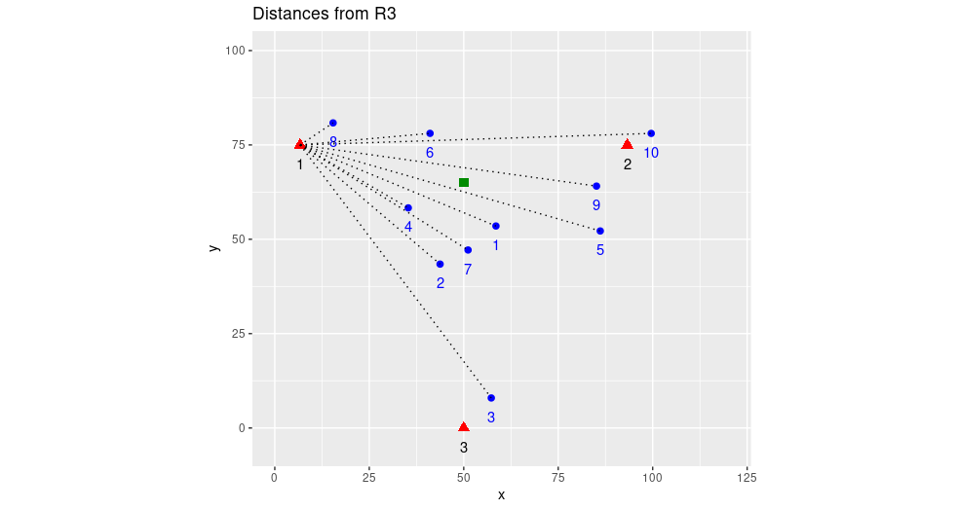
Example Walkthrough Step 2:
Algorithms

Slide 16
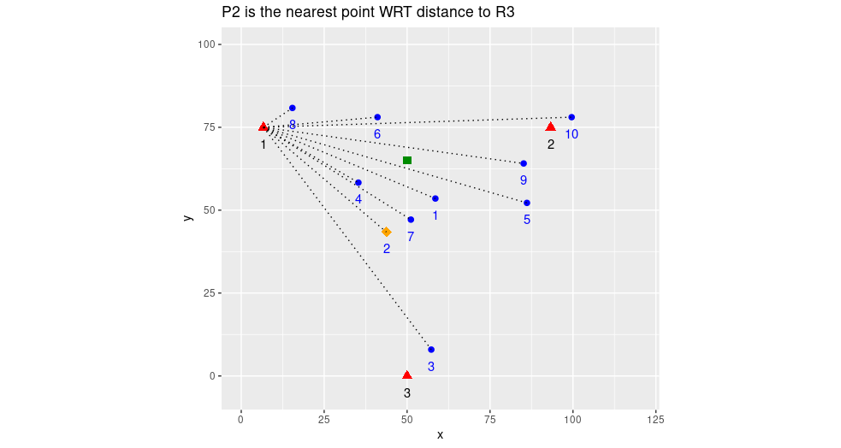
Example Walkthrough Step 3:
Algorithms

Slide 17
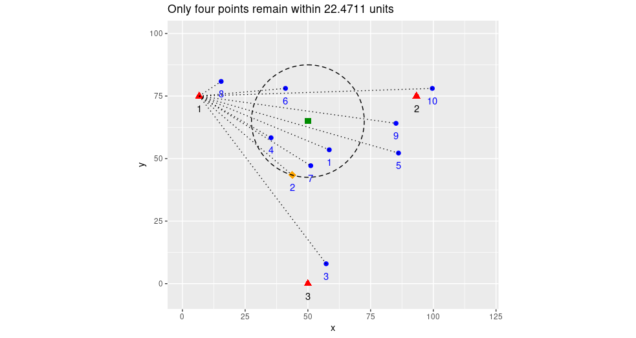
Example Walkthrough Step 4:
Algorithms

Slide 18
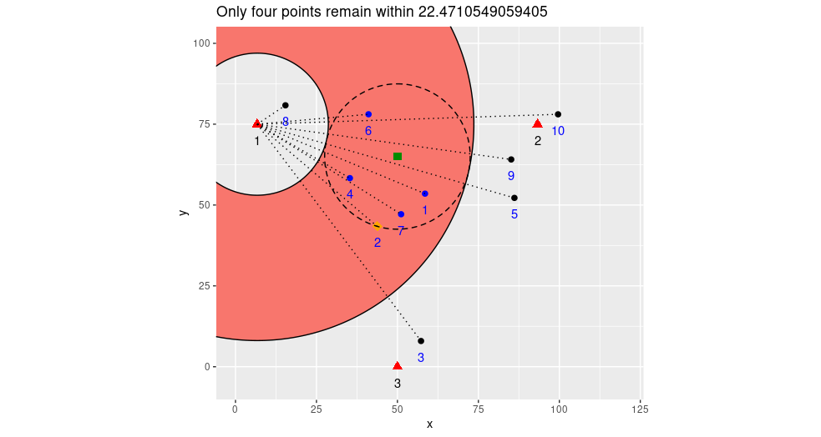
Example Walkthrough Step 5:
Algorithms

Slide 19
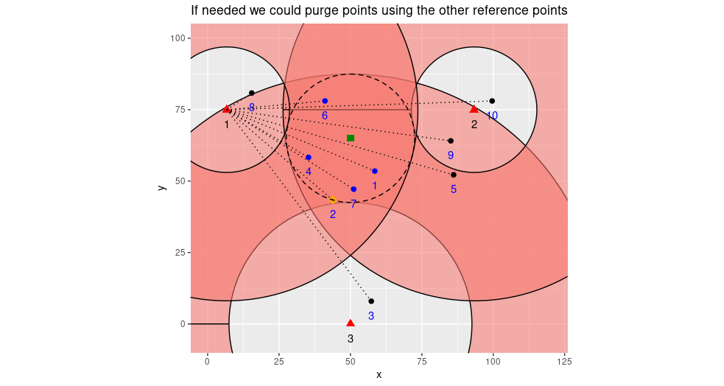
Example Walkthrough Step 6:
Algorithms

Slide 20
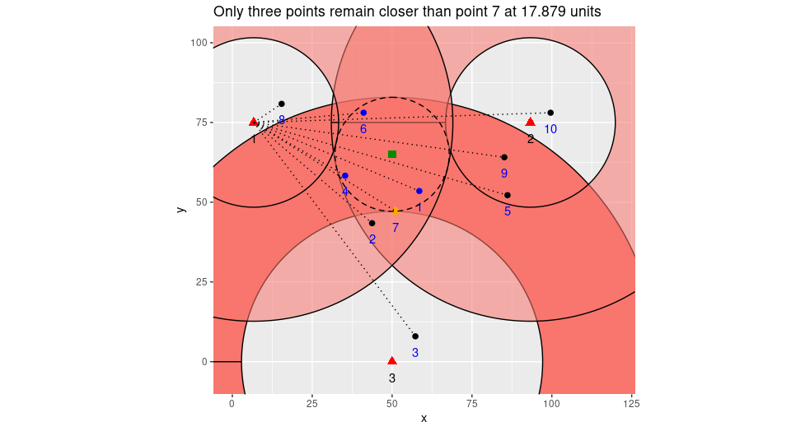
Example Walkthrough Step 7:
Algorithms

Slide 21
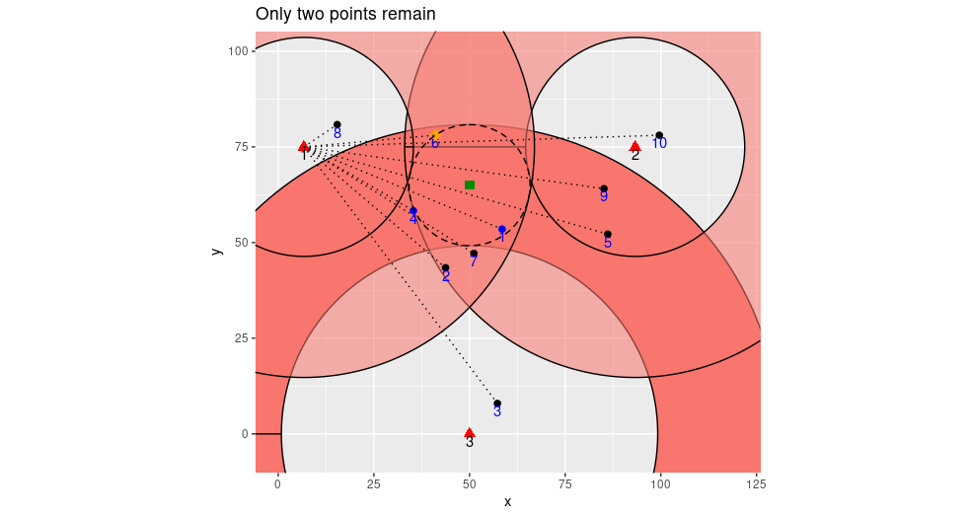
Example Walkthrough Step 8:
Algorithms

Slide 22
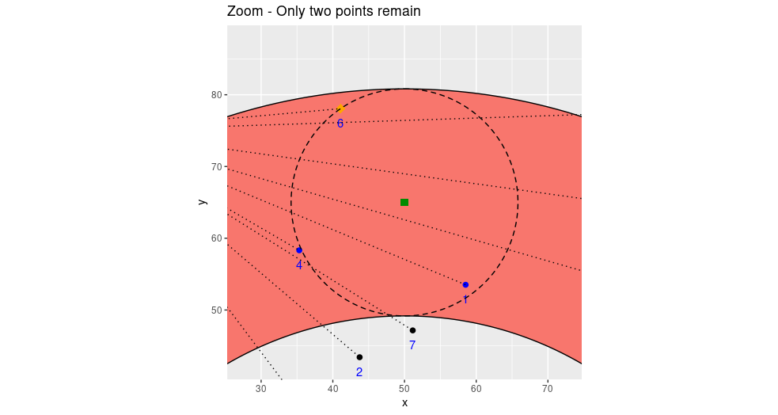
Example Walkthrough Step 9:
Algorithms

Slide 23
Experiment Setup
Experiments
Nearest Neighbor:
Use Open Source “ANN” Software
Modify popular Scikit-Learn to run our algorithms
Use custom geodesic data set (since none already existed)
Use existing Euclidean and Angular data sets for comparison
Network Adequacy:
Use Postgresql due to geodesic distance support
No strong alternatives exist in SQL so we compare to naive use of “st_distance”

Slide 24
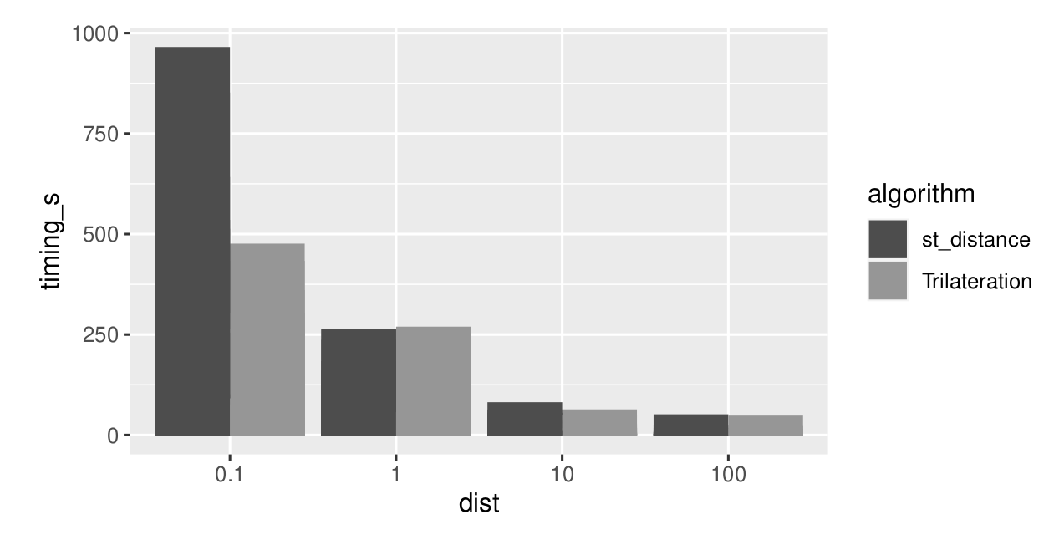
SQL NA Timings:
Results
Good:
50% faster on sparse data (NAP <~ 50%)
Bad:
No major difference for dense data (NAP >~ 80%)

Slide 25
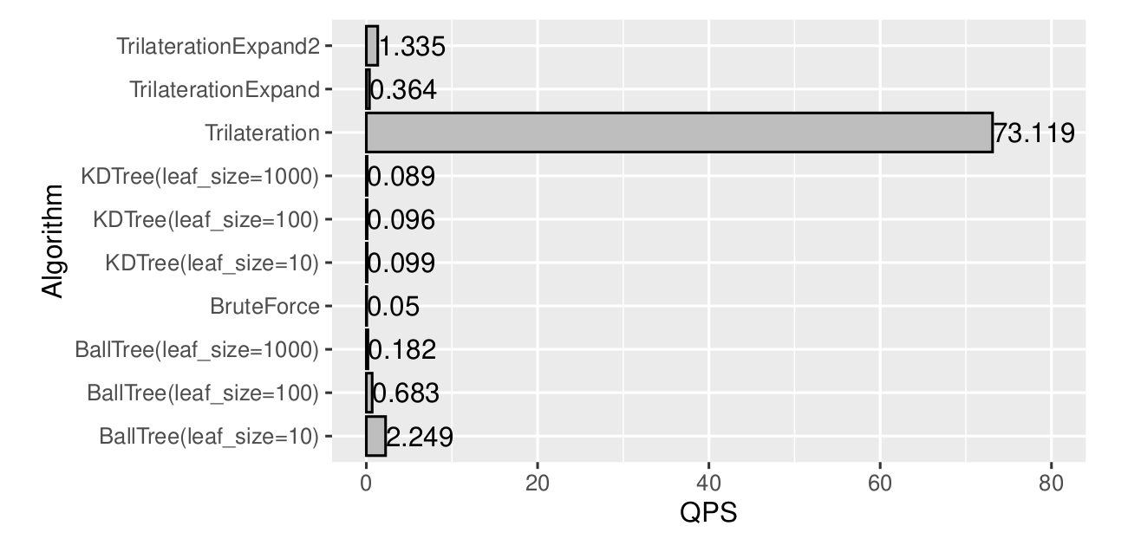
Cython Nearest Neighbor
Results
Good:
50x faster on Geodesic Nearest-Neighbor queries than other algorithms
Also fast pre-processing times not included in the 50x value
Bad:
Horrible performance on Euclidean and other simple distance functions

Slide 26
Objectives Met!
Conclusions &
Future Work
We were able to improve performance in SQL and Scikit-Learn for complex distance functions
We are reasonably optimized for training time, memory space, and insert/move time complexity as well as query performance
But nothing’s perfect...
We did NOT create a magical algorithm that improves in the universal case, but we have good bounds on where our algorithm will be useful in advance

Slide 27
So many things...
Conclusions &
Future Work
There are many, many avenues of research we think this opens up for future work:
This is new code and can likely be optimized:
  Parallelization should be easy but distributed computing versions were not implemented here for compatibility with our testing libraries
  Precision is extremely high; in fact with 64-bit distances and meter units, we are precise to atomic levels measuring on earth. This is unnecessary and probably slows us down.
The Index values themselves have other uses…
  These can be used as an alternate coordinate system instead of Lat/Long
  “Geohashing” based on Trilateration distances could be valuable
Search for other domains with complex distance functions:
  Protein folding? Recommendation Systems? Cryptography?
  Non-metric space applications?

Slide 28
Fin

